Slide 1





Topic
Unit 1
Unit 2
Unit 3
Unit 4
1
Philosophy of Data
Presented by Margaret Nguyen, Heidi Beardsley, and Munkhtsatsral Batdelger

Slide 2
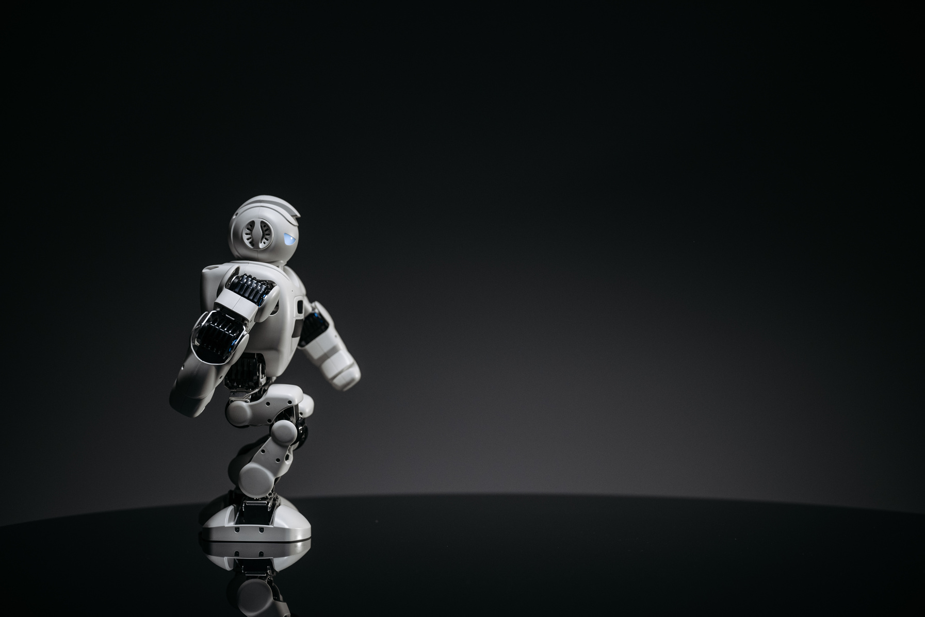
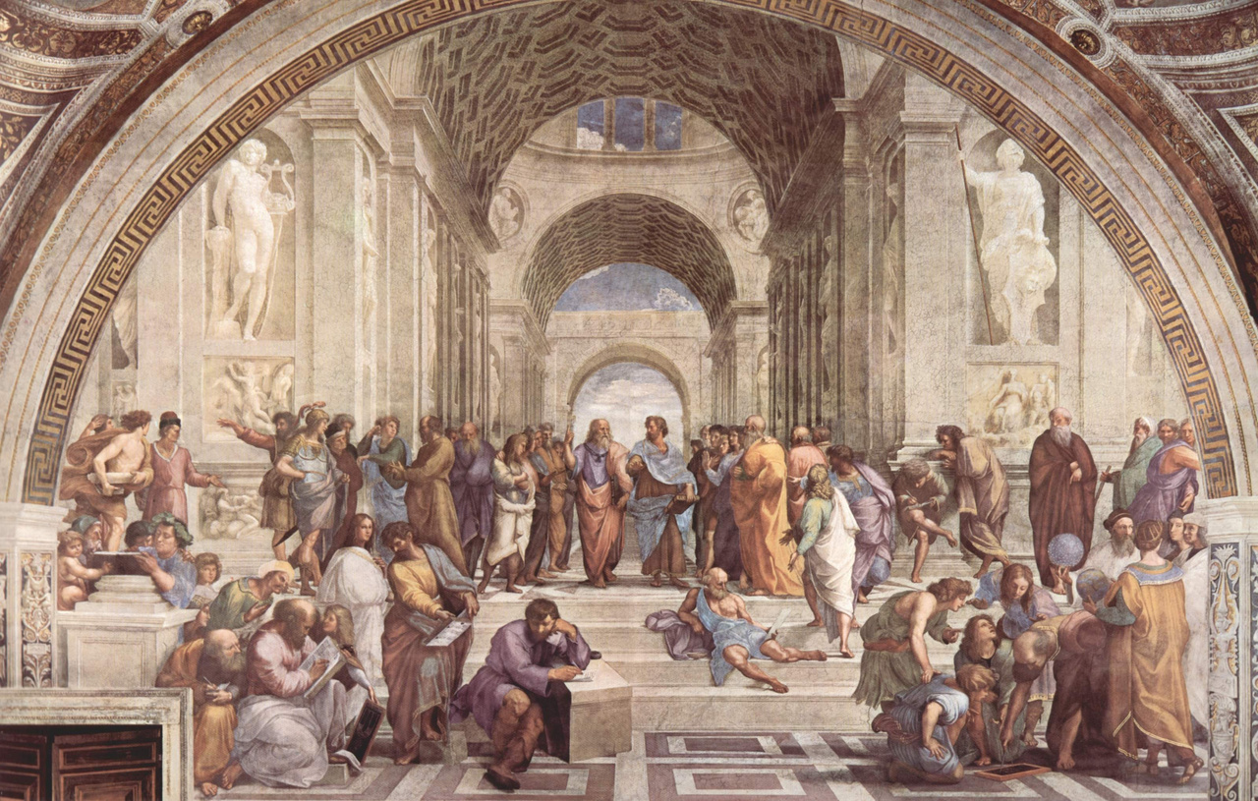

Topic
Unit 1
Unit 2
Unit 3
Unit 4
1
How can we rationally justify inductive arguments?

Slide 3
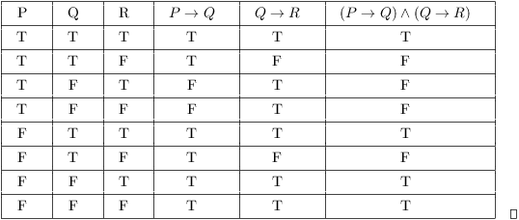

Topic
Unit 1
Unit 2
Unit 3
Unit 4
1
Simple and Complex Statements
Data 400 is fun.
Data 400 is fun and challening.
Truth Tables
shows the truth values of a complex statement for every possible combination of its simple components.
Tautology: Always true.
Self-Contradiction: Always false.
Contingency: Varies depending on components' truth values.
Logical Connectives
~ (Tilde): Negation (e.g., "Not, it is not the case that...")
& (Ampersand): Conjunction (e.g., "And, also, moreover...")
˅ (Wedge): Disjunction (e.g., "Or, unless...")

Slide 4

Topic
Unit 1
Unit 2
Unit 3
Unit 4
1
Evaluating Arguments
Argument: A list of statements, with one conclusion and supporting premises.
Conclusion: The statement being argued for.
Premise: A statement in support of the conclusion.
Testing for Validity:
Construct a truth table.
Check if there's a row where all premises are true and the conclusion is false.
If such a row exists, the argument is invalid; if not, it's valid.
Validity:
Valid: If the premises are true, the conclusion must be true.
Invalid: It's possible for the premises to be true, but the conclusion false.
Soundness:
A sound argument is both valid and has true premises.

Slide 5
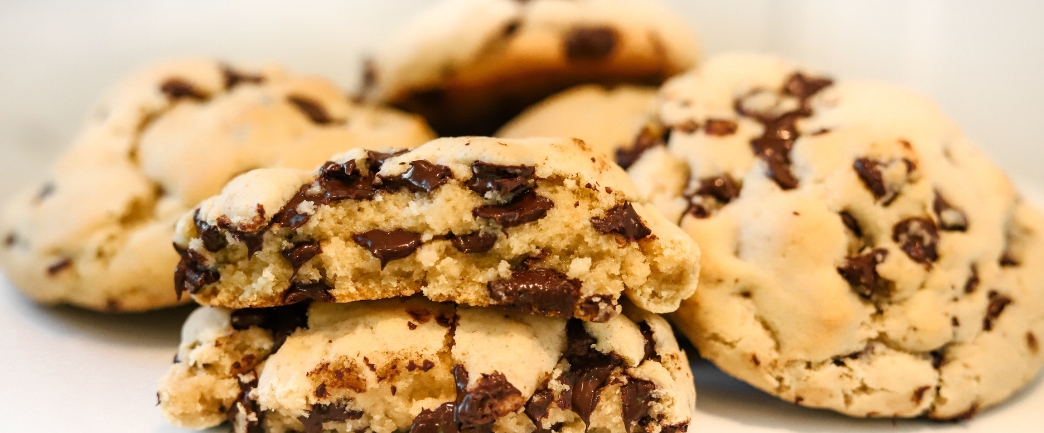
Topic
Unit 1
Unit 2
Unit 3
Unit 4
1
An inductive argument makes a conclusion likely but not certain, based on evidence.
Structure:
Premises: Observations or facts.
Conclusion: A probable outcome based on those observations.
Hume’s Problem of Induction:
We are not rationally justified in accepting the Principle of the Uniformity of Nature (the future will resemble the past) since:
No deductively valid or inductively strong argument for it exists.
Any inductive argument assumes the very principle it's trying to justify.
Example:
Premise: "These five cookies taste great."
Conclusion: "So, all cookies from this recipe will likely taste great."

Slide 6
Topic
Unit 1
Unit 2
Unit 3
Unit 4
1
Hume’s Argument
1. We are rationally justified in accepting the Principle of the Uniformity of Nature only if there is an argument for it that has premises known to be true and is either (i) deductively valid or (ii) inductively strong.
2. There is no such argument.
-----
3. Thus, we are not rationally justified in accepting the Principle.
A Pragmatic Justification for Accepting the Principle
1. We must make predictions about the future.
2. In doing so, we must rely on some principle or rule.
3. No principle is more likely to produce true predictions than the Principle of the Uniformity of Nature.
-----
4. So, we are rational to accept the Principle.

Slide 7

Topic
Unit 1
Unit 2
Unit 3
Unit 4
1
Inductive Argument Structure:
Generalization: "r% of a subset S of population P has trait T. So, r% of P has T."
Prediction: "r% of observed X’s have been Y. The next observed X will likely be Y."
Goodman’s New Riddle of Induction:
Green vs. GRUE:
Green (observed in emeralds) is projectible.
GRUE (changing from green to blue after 2100) is not projectible.
Conclusion: Some regularities are too specific or inconsistent to be reliable predictions.
Projectibility:
Projectible: Regularities that can reliably extend into the future (e.g., "All humans are mammals").
Non-Projectible: Regularities that fail to reliably predict (e.g., "GRUE" concept).

Slide 8
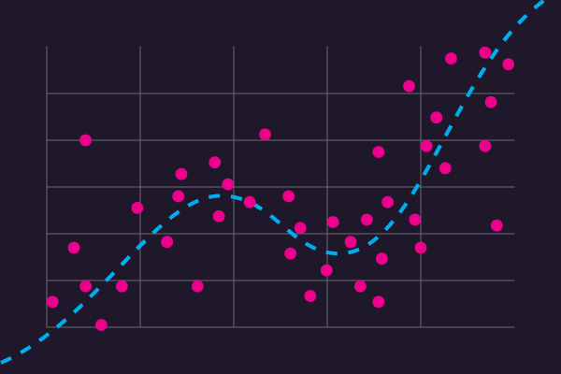
Topic
Unit 1
Unit 2
Unit 3
Unit 4
1
Challenges with Induction
Infinite Regularities: In any finite dataset, there are infinite regularities.
Conflicting Predictions: Different regularities can lead to conflicting predictions.
No Unique Extension: There is no single correct way to extend data into the future, making predictions uncertain.

Slide 9
Topic
Unit 1
Unit 2
Unit 3
Unit 4
1
Is this argument valid? Is this argument sound?
Premise 1: All dogs can fly.
Premise 2: Fido is a dog.
Conclusion: Therefore, Fido can fly.
How can we distinguish between regularities that are reliable for future predictions and those that are not? Can we ever be fully justified in trusting inductive reasoning, given the infinite potential regularities in any dataset?

Slide 10
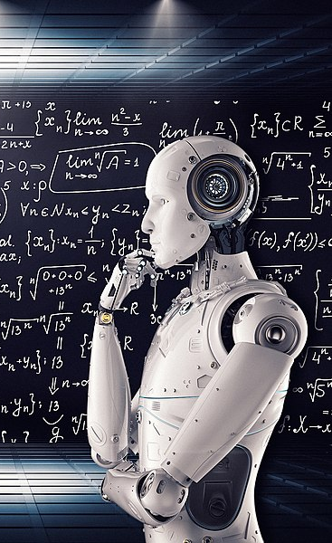
Topic
Unit 1
Unit 2
Unit 3
Unit 4
1
Can a Machine Think?

Slide 11
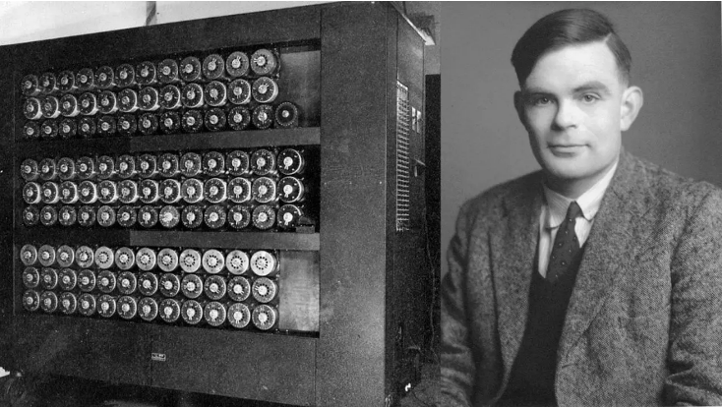

Topic
Unit 1
Unit 2
Unit 3
Unit 4
1
Alan Turing, 1912-1954
Founder of computer science
Creator of the “Turing Machine”
“Computing Machinery and Intelligence” (1950)
Turing’s Question: Can machines think?

Slide 12
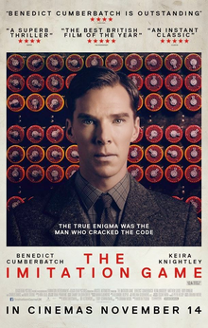
Topic
Unit 1
Unit 2
Unit 3
Unit 4
1
Turing’s “Imitation Game”
A = MACHINE, a computer
B = one of us, human thinkers
C = one of us, human thinkers
C must figure out who which is the human
A “imitates” B
An Objection: The Turing Test wrongly conflates:
Evidence of thinking
Thinking itself

Slide 13

Topic
Unit 1
Unit 2
Unit 3
Unit 4
1
Resemblance Theory of Representation
X represents Y if and only if X resembles Y.
If X resembles Y, then X represents Y.
Resemblance is sufficient for representation.
Running is sufficient for aerobic exercise.
Being a mammal is sufficient for being an animal.
A bench is sufficient for a place to sit.

Slide 14
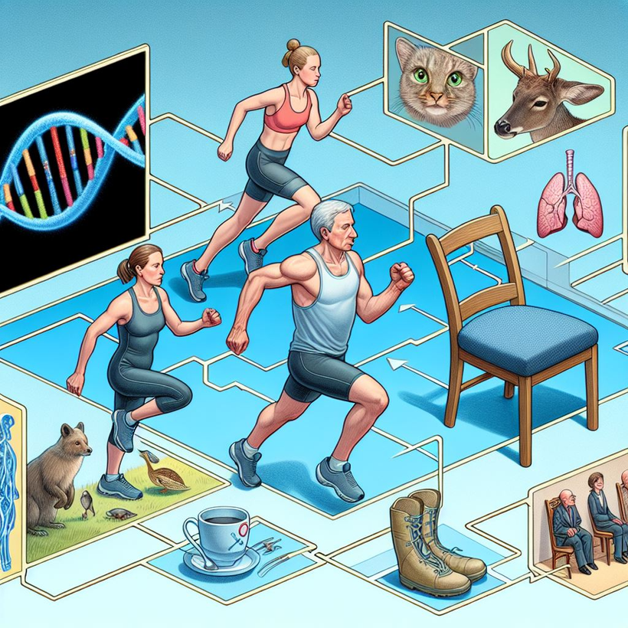
Topic
Unit 1
Unit 2
Unit 3
Unit 4
1
Resemblance Theory of Representation
X represents Y if and only if X resembles Y.
If X resembles Y, then X represents Y.
Resemblance is necessary for representation.
Accelerated heart rate is necessary for aerobic exercise.
Having DNA is necessary for being an animal.
A place to rest your butt is necessary for a place to sit.

Slide 15
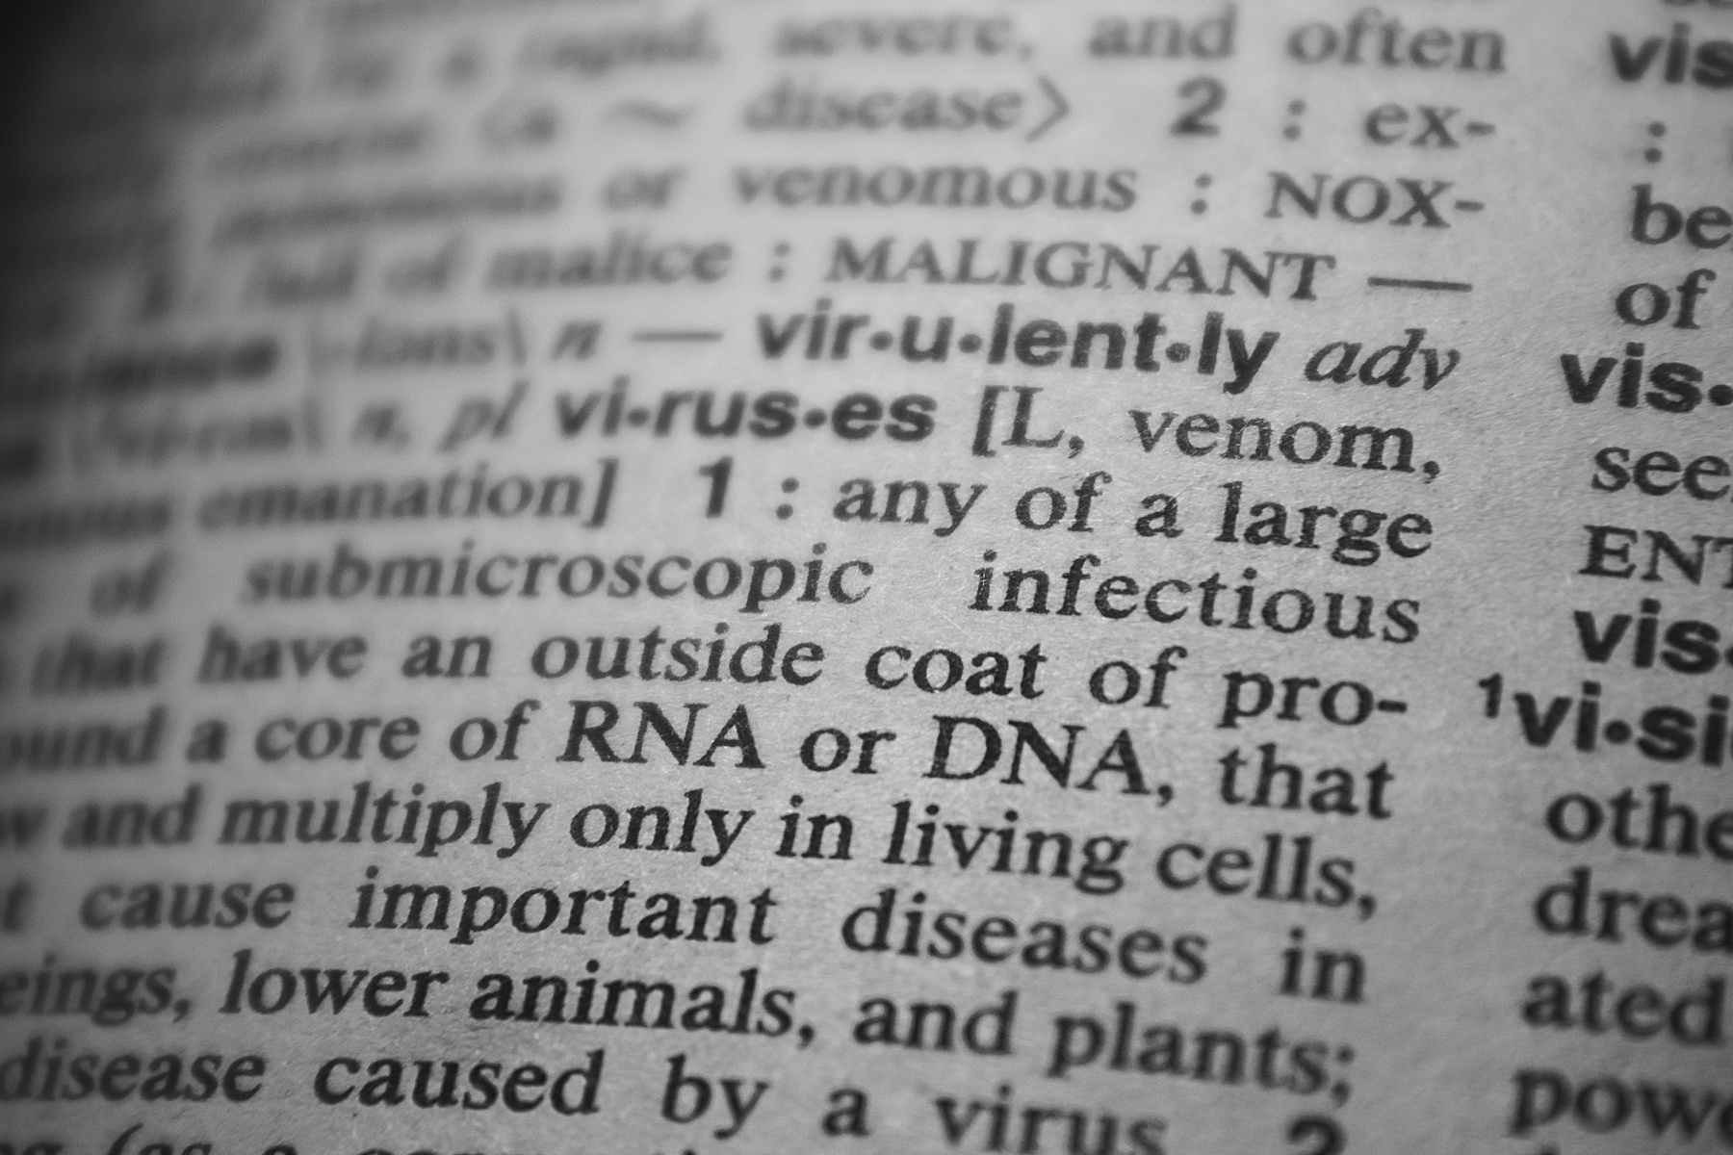
Topic
Unit 1
Unit 2
Unit 3
Unit 4
1
“syntax alone is not sufficient for semantics”
Semantics: the meaning or content of a symbol.
Example: ‘Rojo’ in Spanish means red.
Syntax: rules that specify how symbols can and cannot be combined.
Example: Every sentence must have a noun and a verb.

Slide 16
Topic
Unit 1
Unit 2
Unit 3
Unit 4
1
The Chinese Room
[I]magine that you are locked in a room, and in this room are several baskets full of Chinese symbols. Imagine that you (like me) do not understand a word of Chinese, but that you are given a rule book in English for manipulating these Chinese symbols. The rules specify the manipulations of the symbols purely formally, in terms of their syntax, not their semantics. So the rule might say: “Take a squiggle-squiggle sign out of basket number one and put it next to a squiggle-squiggle sign from basket number two.” Now suppose that some other Chinese symbols are passed into the room, and that you are given further rules for passing back Chinese symbols out of the room. Suppose that unknown to you the symbols passed into the room are called “questions” by the people outside the room, and the symbols you pass back out of the room are called “answers to the questions.” Suppose, furthermore, that the programmers are so good at designing the programs and that you are so good at manipulating the symbols, that very soon your answers are indistinguishable from those of a native Chinese speaker. (343)

Slide 17

Topic
Unit 1
Unit 2
Unit 3
Unit 4
1
Does the Chinese Room understand Chinese?
Searle: NO!
What is Searle’s argument?
1. Thinking requires sensitivity to semantics, the meaning or content of thoughts.
2. Computer programs are purely syntactical; they manipulate items only according to their form, shape, or structure.
3. “Syntax alone is not sufficient for semantics.”
-----
4. So, computers can’t think.
Notes:
“syntax alone is not sufficient for semantics” (344)
Semantics: the meaning or content of a symbol.
Example: ‘Rojo’ in Spanish means red.
Syntax: rules that specify how symbols can and cannot be combined.
Example: Every sentence must have a noun and a verb.

Slide 18
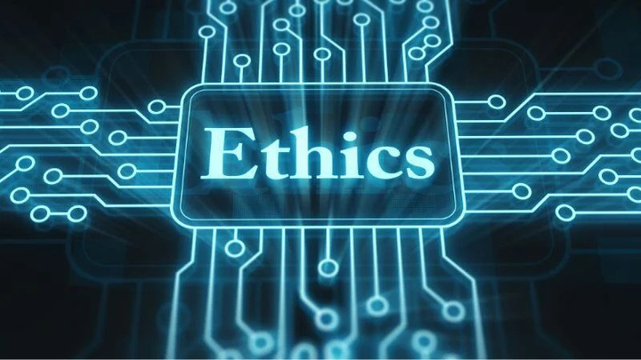
Topic
Unit 1
Unit 2
Unit 3
Unit 4
1
Ethical Skepticism
& Data Analytics

Slide 19
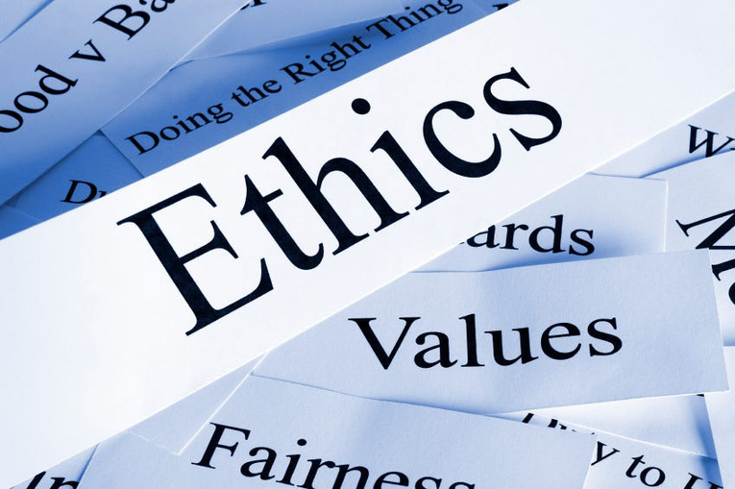
Topic
Unit 1
Unit 2
Unit 3
Unit 4
1
Ethics
Ethics is the branch of philosophy that examines what is right and wrong in human behavior.
How do we determine ethical standards?
cultural norms
philosophical reasoning
societal consensus
legal framework

Slide 20
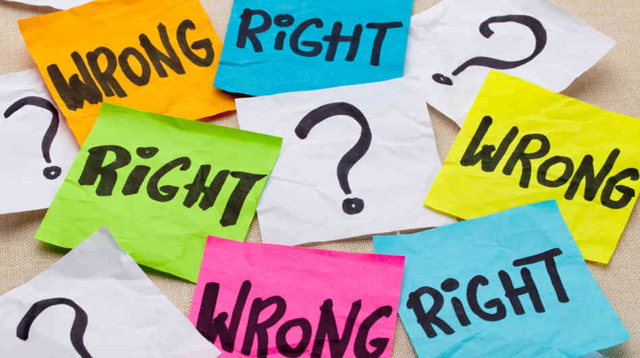
Topic
Unit 1
Unit 2
Unit 3
Unit 4
1
Ethical Objectivism
Some moral standards are objectively correct and that some moral claims are objectively true.
Objectively true claims
Earth goes around the sun
Animal cells don’t have cell walls.

Slide 21
Topic
Unit 1
Unit 2
Unit 3
Unit 4
1
Moral Skepticism
The philosophical view that questions the validity of moral claims and ethical beliefs. It posits that there are no objective moral truths, suggesting that moral judgments are influenced by personal biases and cultural contexts.
Two forms:
Moral Nihilism:
there are no moral truths at all
Ethical Relativism:
there are some moral truths but that they are relative to each person or society

Slide 22
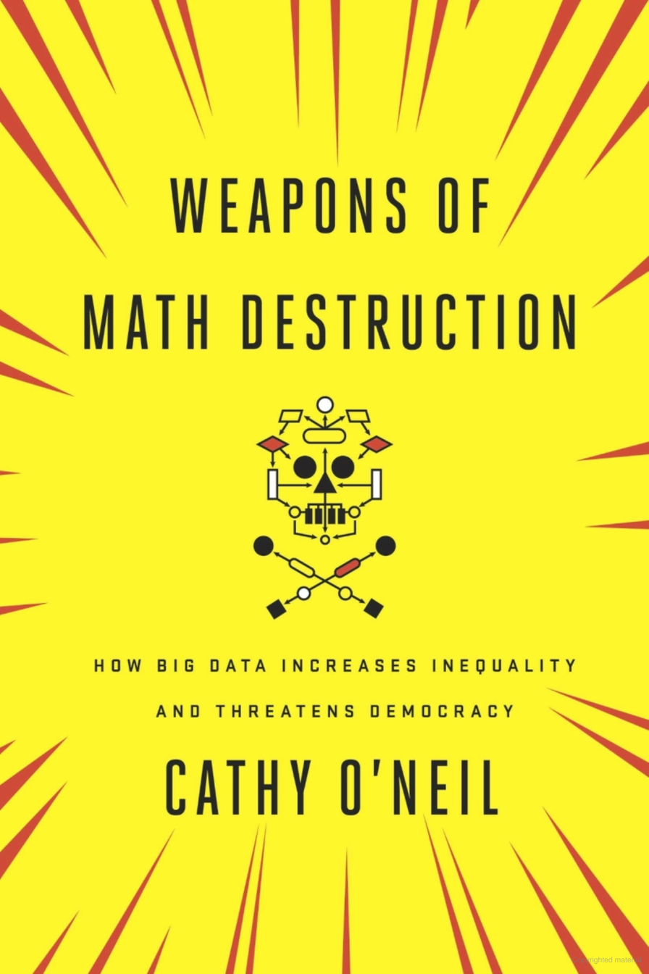
Topic
Unit 1
Unit 2
Unit 3
Unit 4
1
Ethical Skepticism in Data Analytics
Data Analysts must critically assess ethical implications and biases in their work.
Recognizing that algorithms can reinforce existing biases is crucial for ethical practice.
O’Neil examines how poorly designed algorithms can exacerbate social inequality.
Key Examples:
Credit Scoring Models
Predictive Policing

Slide 23

Topic
Unit 1
Unit 2
Unit 3
Unit 4
1
Data Analysts can uphold ethical standards by:
Developing a clear ethical framework for data usage.
Engaging in ongoing training and discussions about ethics in data analytics.
Conducting regular audits of algorithms to identify and address bias.
Organizations can integrate ethical considerations by:
Establishing clear ethical guidelines and policies for data use.
Fostering a culture of ethical awareness and responsibility.

Slide 24
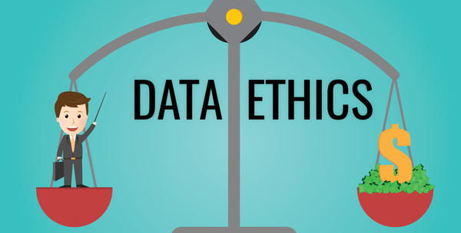
Topic
Unit 1
Unit 2
Unit 3
Unit 4
1
How might data analytics endanger or enhance fairness, autonomy, or respect?

Slide 25
Topic
Unit 1
Unit 2
Unit 3
Unit 4
1
Psychological Egoism: A theory that all human actions aim to avoid personal loss or gain personal benefit.
Altruism: If Psychological Egoism is true, altruism does not exist.
Counterpoint:
Can strongest desires ever be non-self-interested?
What about strictly conscientious actions (moral duties)?
Key Argument:
All actions are motivated by one's strongest desire.
Strongest desires pursue self-interest.
Therefore, all actions promote self-interest.

Slide 26

Topic
Unit 1
Unit 2
Unit 3
Unit 4
1
Psychological Egoism:
All human actions aim at avoiding personal loss or gaining benefit.
Empathy-Altruism Hypothesis: Evidence suggests altruistic motivation, challenging Psychological Egoism.
Ethically Significant Issues:
Benefits: Human understanding, efficiency, predictive accuracy.
Harms: Privacy, security, fairness, transparency, and autonomy.
Ethical Egoism:
Actions are morally right if they promote one's self-interest.
Critique: Ethical Egoism can justify harmful actions (e.g., murder, theft) if in one's self-interest, violating moral rights.

Slide 27
Topic
Unit 1
Unit 2
Unit 3
Unit 4
1
Consequentialism:
Morally right actions maximize goodness in the world.
Optimific Action: Greatest balance of benefits over drawbacks.
Act Utilitarianism:
Principle of Utility: Actions are morally required if they improve overall well-being more than any alternatives.
Key Misunderstandings:
It's not about benefiting the most people or maximizing happiness but creating the greatest net balance of happiness.
Slippery Slope Argument:
Criticizes actions based on long-term harmful consequences.
Raises questions about whether disaster is inevitable.
Hedonism:
Well-being = happiness (pleasure + absence of pain).
Intrinsic value: Attitudinal pleasure (enjoyment).

Slide 28
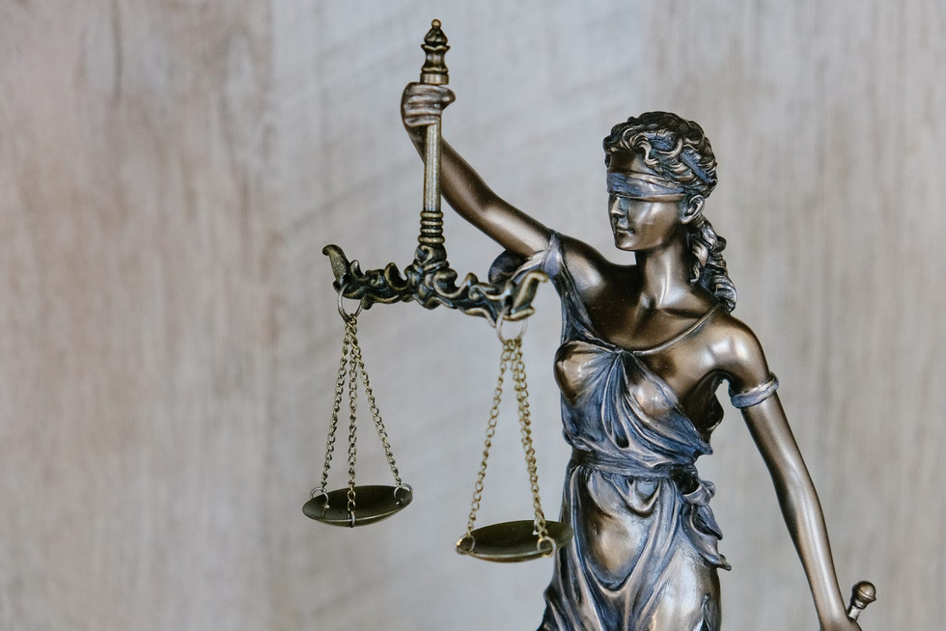
Topic
Unit 1
Unit 2
Unit 3
Unit 4
1
Morality & Fairness:
Actions are morally acceptable if their maxims are universalizable (can be applied to everyone).
Fairness tests:
What if everyone did that?
How would you feel if it was done to you?
Good Will:
The only thing good in all circumstances.
Moral worth comes from acting out of duty, not just for personal gain.
Means vs. Mere Means:
Treating someone as a means: using them with respect to their goals.
Treating someone as a mere means: using them solely for your own goals (disrespectful).

Slide 29
Topic
Unit 1
Unit 2
Unit 3
Unit 4
1
Categorical Imperative:
Always treat people as ends in themselves, never as mere means.
Autonomy and rationality make individuals deserving of respect.
Moral Luck:
Morality is sometimes shaped by factors outside our control (e.g., circumstances, outcomes, upbringing).
Raises questions about how much blame or praise one deserves.

Slide 30
Questions to consider:
In what ways do you believe a machine's ability to process data might mimic human thought processes? Are there aspects of human thinking that machines can never replicate?
What do you envision as the future of data analytics? How might emerging technologies shape the way we understand and use data?
In what ways can we measure fairness in data analytics? What are some potential pitfalls to watch for when trying to ensure fairness?

